Slide 1

ASP.NET Core Databases
Working with Entity Framework Core
SoftUni Team
Technical Trainers
Software University
https://softuni.bg

Slide 2
Table of Content
1. Entity Framework Core
Code First Approach
2. EF Core Components
3. EF Core Configuration
Fluent API
4. CRUD Operations
5. Database Migrations

Slide 3
Questions?
sli.do
#csharp-web

Slide 4

Code First Approach
Entity Framework Core

Slide 5
Entity Framework Core: Overview
The standard ORM framework for .NET and .NET Core
Provides LINQ-based data queries and CRUD operations
Automatic change tracking of in-memory objects
Works with many relational databases (with different providers)
Open source with independent release cycle

Slide 6

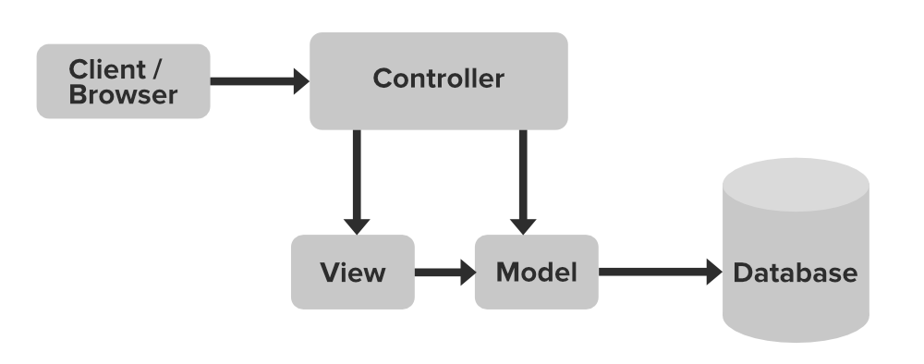
ASP.NET Core MVC + Entity Framework
ASP.NET MVC controllers
EF Core
Razor views: (.cshtml)

Slide 7
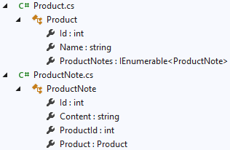
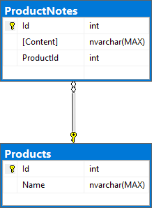
What is the Code First Approach?
Code First means to write the .NET classes and let EF Core create the database from the mappings

Slide 8
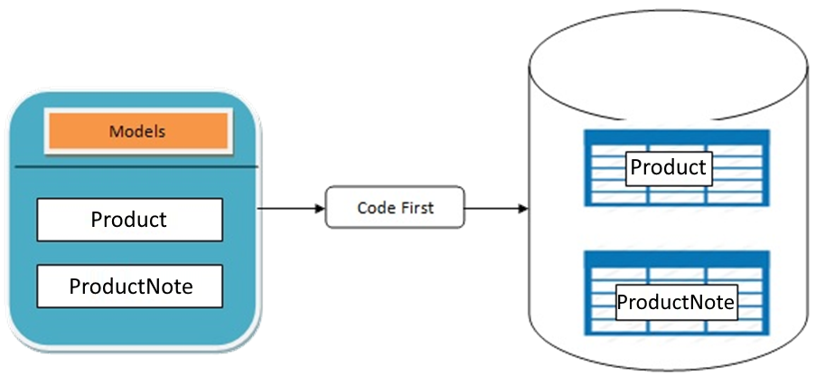
Why Use Code First?
Write code without having to define mappings in XML or create database tables
Define objects in C# format
Enables database persistence with no configuration
Changes to code can be reflected
(migrated) in the schema
Data Annotations or Fluent API
describe properties
Key, Required, MinLength, etc.

Slide 9
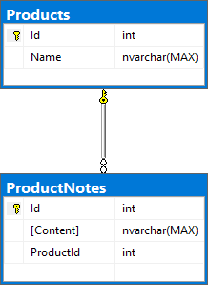
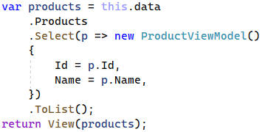

Code First Basic Workflow (1)
Define the data model (Code First or Scaffold from DB)
Write & execute query over IQueryable
EF generates & executes an SQL query in the DB

Slide 10
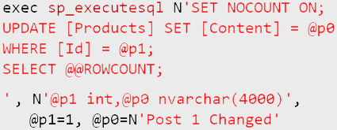

Code First Basic Workflow (2)
EF transforms the query results into .NET objects
Modify data with C# code and call "Save Changes()"
Entity Framework generates & executes SQL command to modify the DB

Slide 11
EF Core Components
DbContext
Product
ProductNotes
Overview of System Objects

Slide 12
Domain Classes (Models) (1)
Bunch of normal C# classes (POCO)
May contain navigation properties for table relationships
Recommended to be in a separate class library
public class ProductNote
{
public int Id { get; set; }
public string Content { get; set; }
public int ProductId { get; set; }
public Product Product { get; set; }
}
Primary key
Foreign key
Navigation property

Slide 13
Domain Classes (Models) (2)
Another example of a domain class (model)
public class Product
{
public int Id { get; set; }
public string Name { get; set; }
public IList<ProductNote> ProductNotes { get; set; }
= new List<ProductNote>();
}
One-to-many relationship

Slide 14
The DbContext Class
Usually named after the database e.g. ShoppingListDbContext
Manages model classes using DbSet<T> type
Easily navigate through table relations
Managing database creation/deletion/migration
Executing LINQ queries as native SQL queries
DbContext properties:
Database - EnsureCreated/Deleted methods, DB Connection
ChangeTracker - holds info about the automatic change tracker
public class ShoppingListDbContext : DbContext
Inherits the DbContext class

Slide 15
Defining DbContext Class
EF Reference
using Microsoft.EntityFrameworkCore;
public class ShoppingListDbContext : DbContext
{
public ShoppingListDbContext
(DbContextOptions<ShoppingListDbContext> options)
: base(options)
=> this.Database.EnsureCreated();
public DbSet<Product> Products { get; set; }
public DbSet<ProductNote> ProductNotes { get; set; }
protected override void OnModelCreating(ModelBuilder builder)
{
builder.Entity<Product>()
.HasMany(p => p.ProductNotes)
.WithOne(r => r.Product);
}
}
Accepts options through the constructor
Collections of entities
Use the Fluent API to describe our table relations to EF Core

Slide 16


EF Core Configuration
NuGet Packages, Configuration

Slide 17
EF Core Setup
To add EF Core support to a project in Visual Studio:
Install it from Package Manager Console
Or using .NET Core CLI
EF Core is modular – any data providers must be installed too:
To use the Entity Framework Core tools, install also:
Install-Package Microsoft.EntityFrameworkCore
dotnet add package Microsoft.EntityFrameworkCore
Microsoft.EntityFrameworkCore.SqlServer
Microsoft.EntityFrameworkCore.Tools

Slide 18
How to Connect to SQL Server? (1)
In ASP.NET Core connection string is in the appsettings.json file and has the following properties:
"ConnectionStrings": {
"DefaultConnection": "Server=(localdb)\\mssqllocaldb;
Database=ShoppingList;Trusted_Connection=True;
MultipleActiveResultSets=true"}

Slide 19
How to Connect to SQL Server? (2)
Use the DbContext and tell it to use SQL with the connection string in in the Program class:
var connectionString = builder .Configuration .GetConnectionString("DefaultConnection");
builder
.Services .AddDbContext<ShoppingListDbContext>(
x => x.UseSqlServer(connectionString));

Slide 20
Database.EnsureCreated()
When you create the DB context, you can call this.Database.EnsureCreated()
This will create the DB + schema, when the DB is missing
EnsureCreated() does not use migrations → you should drop the enrite DB when you change the DB schema
Database Exists?
Yes
Use Database
No
Create Database

Slide 21
Database.EnsureCreated() – Example
public class ShoppingListDbContext : DbContext
{
public ShoppingListDbContext(
DbContextOptions<ShoppingListDbContext> options) : base(options)
=> this.Database.EnsureCreated();
// This will create the DB schema if the DB does not exist
// Any change in the data entities will not change the DB
// You should update the DB by hand
// or drop and re-create the DB after each entity change!
…
}

Slide 22
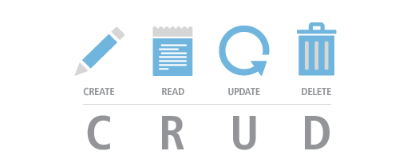
CRUD in ASP.NET Core MVC with EF
The "ShoppingList" App

Slide 23
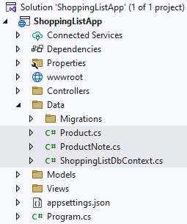




The "ShoppingList" App
Create an MVC app with the models and db context from the previous slides
Perform CRUD operations on the database to create the following functionalities:
Display all products
Add a product
Edit a product
Delete a product

Slide 24
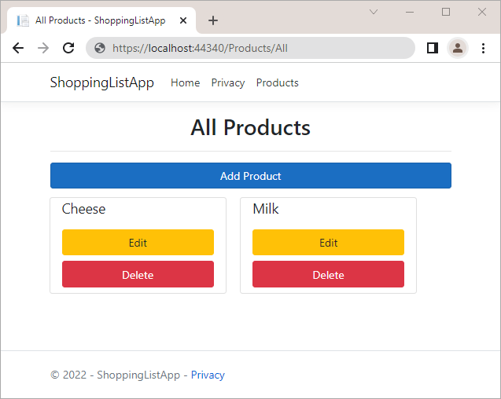
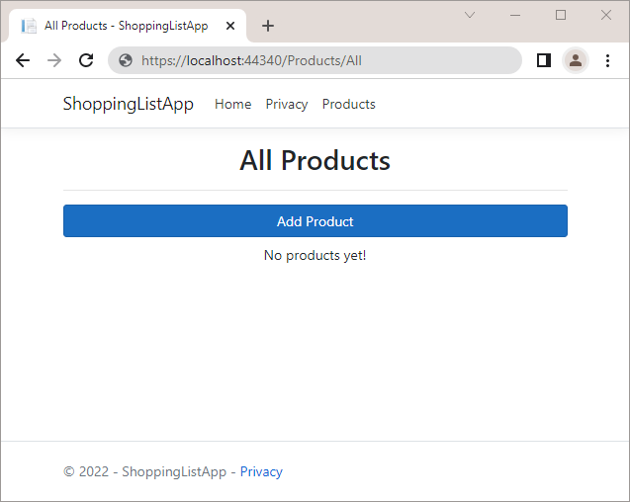
The "All Products" Page (Reading Data)
It should display all added products with their content + [Edit] and [Delete] buttons + [Add Post] button

Slide 25
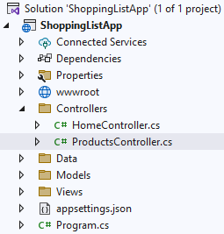
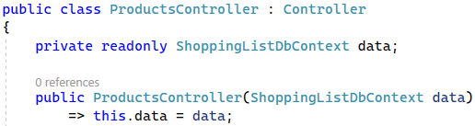
ProductsController Class
Create a new ProductsController in the "Controllers" folder
Inject the ProductDbContext through the constructor
And assign it to a variable to use it

Slide 26
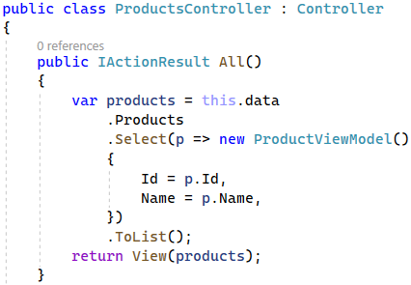
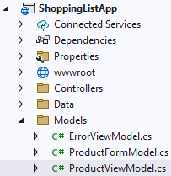
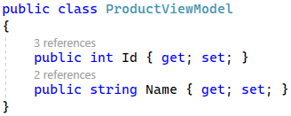
Reading Data (Controller + Model)
Extract the products from the database
Project products to a model collection
Passes the model collection to a view

Slide 27
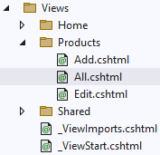
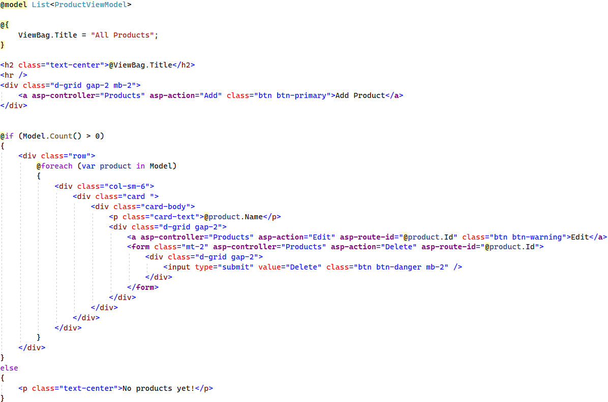
Reading Data (View)

Slide 28
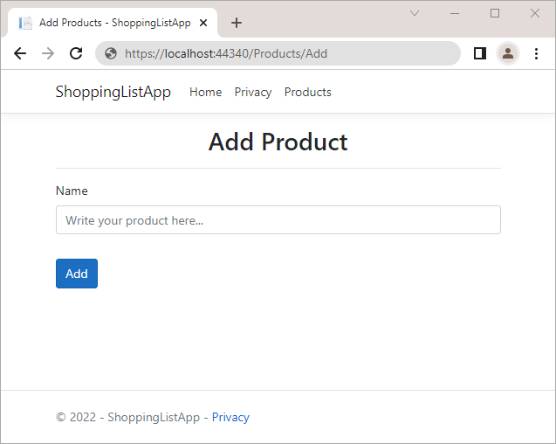
The "Add Product" Page (Creating New Data)
It should display a form for adding a product

Slide 29
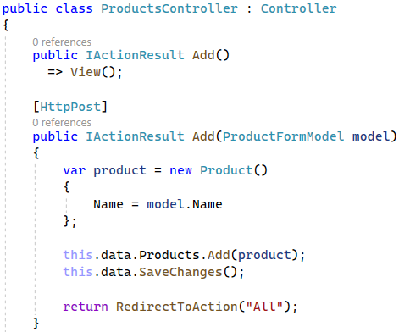

Creating New Data (Controller + Model)
Create a new Product object
Add the object to the DbSet
Execute SQL statements

Slide 30
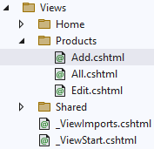
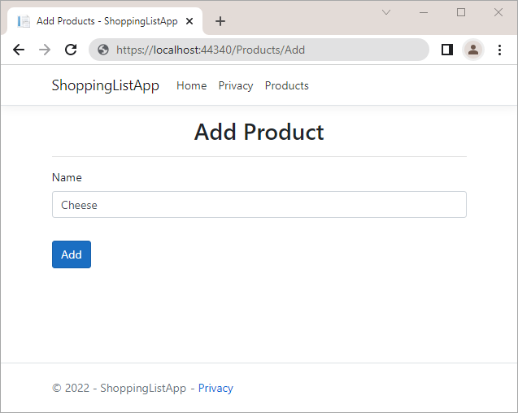
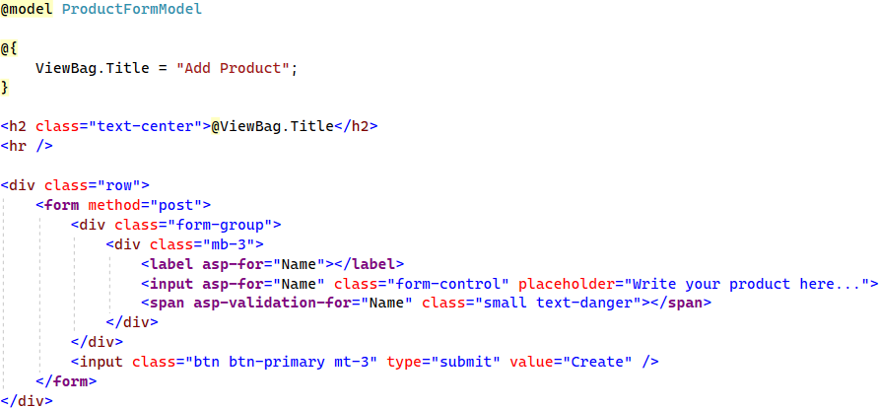
Creating New Data (View)

Slide 31
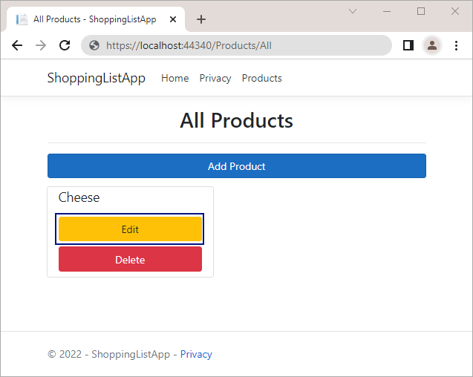

The "Edit Product" Page (Updating Existing Data)
To edit a product, click on its [Edit] button
It should display a form for editing a product with the product data in the fields

Slide 32
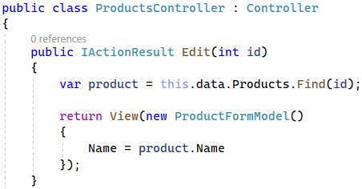
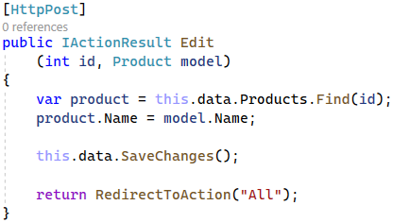
Updating Existing Data (Controller)
HTTP GET → display the edit form
HTTP POST → update the DB
SELECT the product for update
Pass a product model to a view
Execute an SQL UPDATE

Slide 33
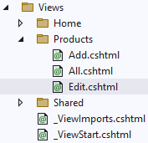
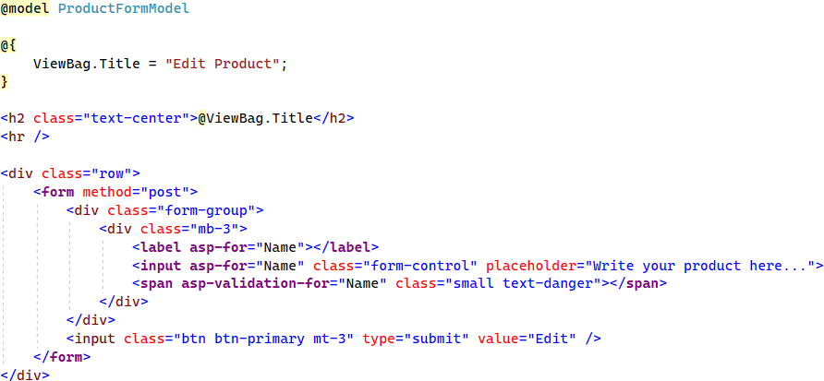

Updating Existing Data (View)

Slide 34
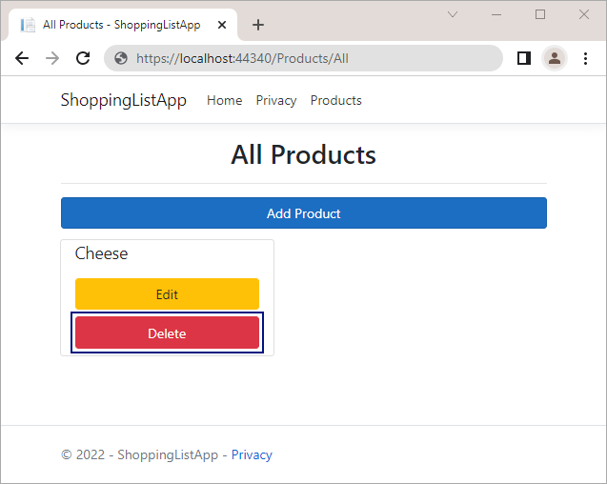
Deleting Existing Data
To delete a product, press its [Delete] button
It will send a "POST" request to the controller

Slide 35
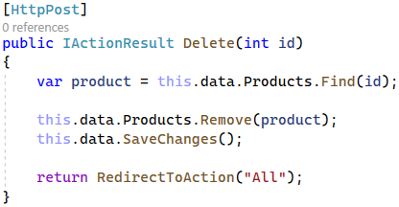
Deleting Existing Data (Controller)
Execute the SQL DELETE command
Mark the entity for deleting at the next save

Slide 36
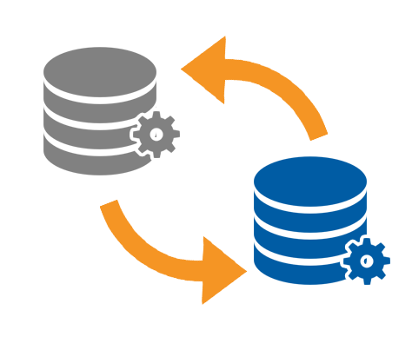
Database Migrations
Scripts for Modifying Table Structure in the DB

Slide 37

What Are Database Migrations?
Updating database schema without losing data
Adding/dropping tables, columns, etc.
Migrations in EF Core keep their history
Entity Classes, DB Context versions are all preserved
Automatically generated by certain EF tools

Slide 38
Migrations in EF Core
To add a migration in EF Core
Use the EF CLI Tools
Use the Package Manager Console
To undo a migration, use one of the two ways
Commit changes to the database
dotnet ef migrations add {MigrationName}
Add-Migration {MigrationName}
dotnet ef migrations remove {MigrationName}
Remove-Migration
Removes the last migration
dotnet ef database update
Update-Database
Migrates any DB changes on startup
db.Database.Migrate(); // Auto migrate at start

Slide 39
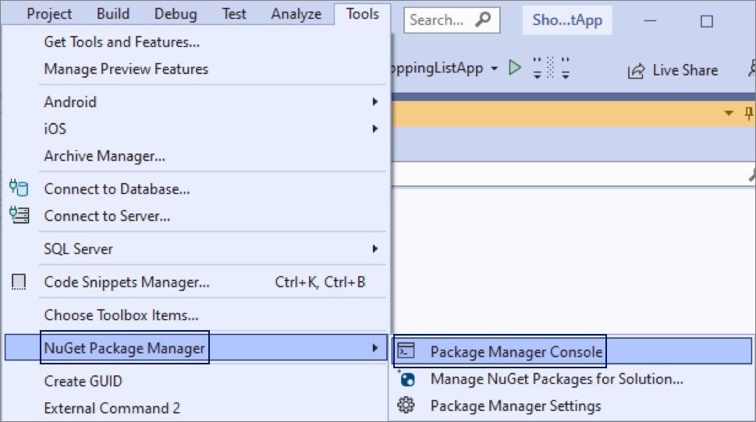
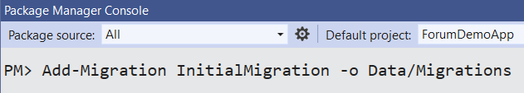
Migrate the "ShoppingListDemo" App
Install the package
Open the Package
Manager Console
Create a migration
Microsoft.EntityFrameworkCore.Tools
Migration will be created in the "Data/Migrations" folder

Slide 40
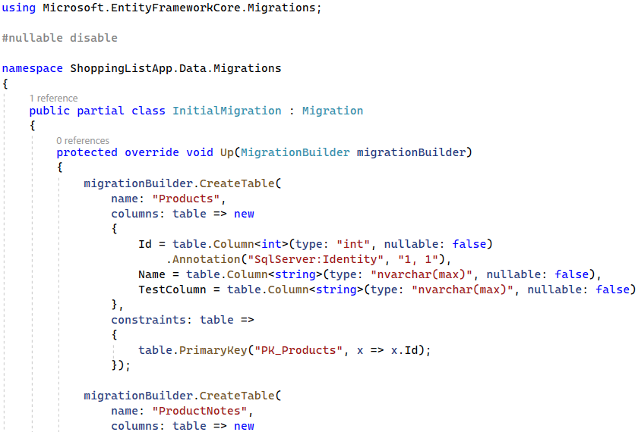
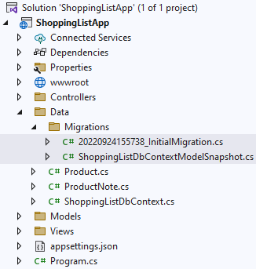
Migrate the "ShoppingListDemo" App (2)

Slide 41
Auto Run Migration Scripts at Startup
public class ShoppingListDbContext : DbContext
{
public ShoppingListDbContext(
DbContextOptions<ShoppingListDbContext> options) : base(options)
=> this.Database.Migrate(); }
This will apply the migration scripts (if not yet applied)
Simple, but can cause problems → not recommended in production
Recommended approach: migrate the database by hand
dotnet ef database update

Slide 42

Summary
…
…
…
EF Core maps database objects to database schema
Code First approach creates a database, based on C# classes that we create
LINQ can be used to query the DB through the DB context
Database migrating updates the database schema to match app data models

Slide 43
Questions?
Notes:
43

Slide 44













SoftUni Diamond Partners

Slide 45

Educational Partners

Slide 46
Trainings @ Software University (SoftUni)
Software University – High-Quality Education, Profession and Job for Software Developers
softuni.bg, about.softuni.bg
Software University Foundation
softuni.foundation
Software University @ Facebook
facebook.com/SoftwareUniversity
Software University Forums
forum.softuni.bg
Notes:
46

Slide 47

License
This course (slides, examples, demos, exercises, homework, documents, videos and other assets) is copyrighted content
Unauthorized copy, reproduction or use is illegal
© SoftUni – https://about.softuni.bg/
© Software University – https://softuni.bg
Notes:
47

